Slide 1




A Sidescroller Game by Ted‘s Entertainment

Slide 2

Agenda
Business Cases / Preparation
Implementation and Quality
User Testing
Demo

Slide 3



Reflect Idea
Sidescroller game
Main character
Enjoyable and simple game
01.07.2020
1

Slide 4
Business Cases / Preparation
Einteilung in Roles [ok]
YouTrack Dokumente [ok]
SRS Dokument [ok]
Bilder und Dokumente [ok]
Neuer – alter Scope [ok]
Blog [fast]
01.07.2020
1

Slide 5
Business Cases / Preparation

Slide 6
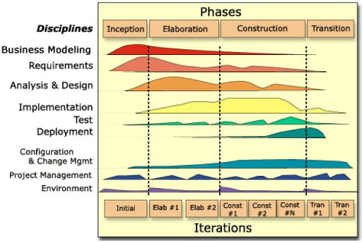
RUP
https://lh3.googleusercontent.com/proxy/SjOyKZHD7eOFFkuaHUrA_MXBW-CPNk0sCL89n4gC878lhM091WyS67gVfQsWwLZsG3aALSOE2wSWYcNn955gAQxpDuU
01.07.2020
3

Slide 7
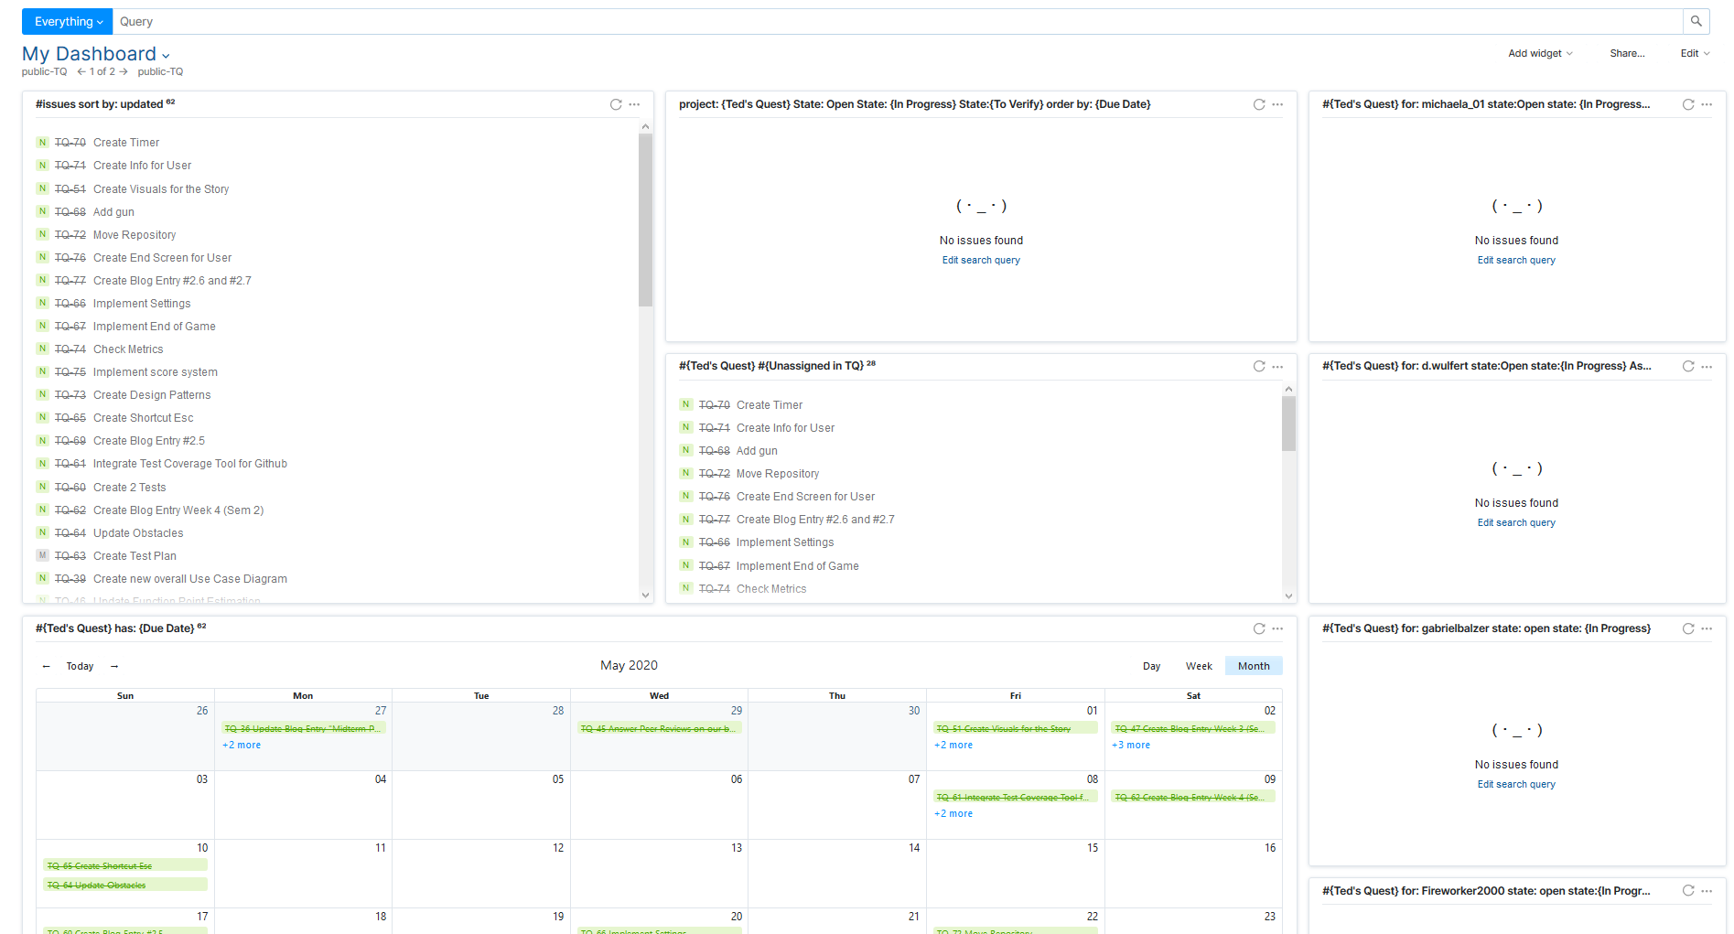
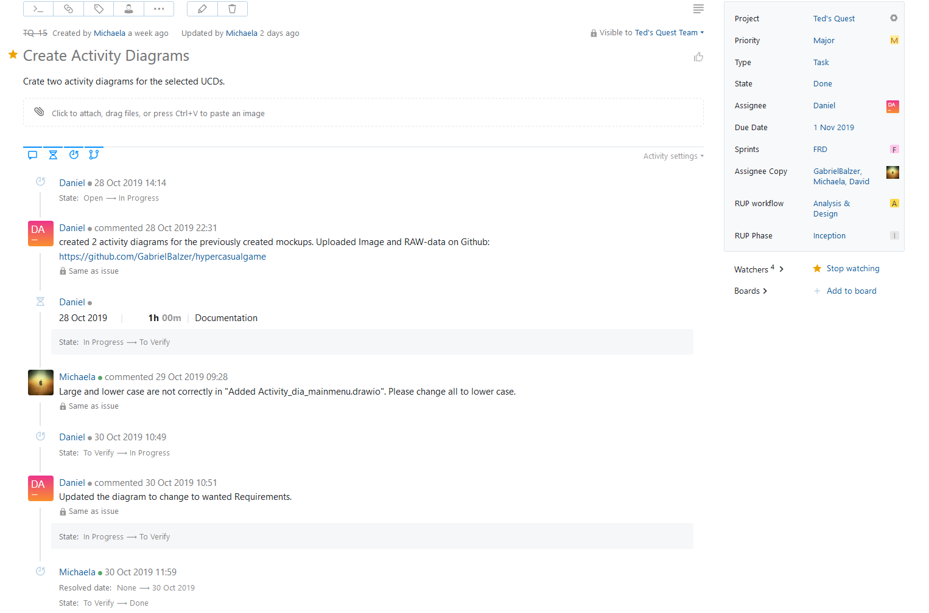
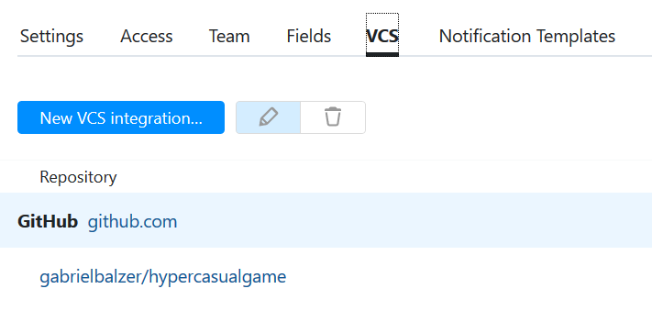
Management Methods – YouTrack
01.07.2020
4

Slide 8
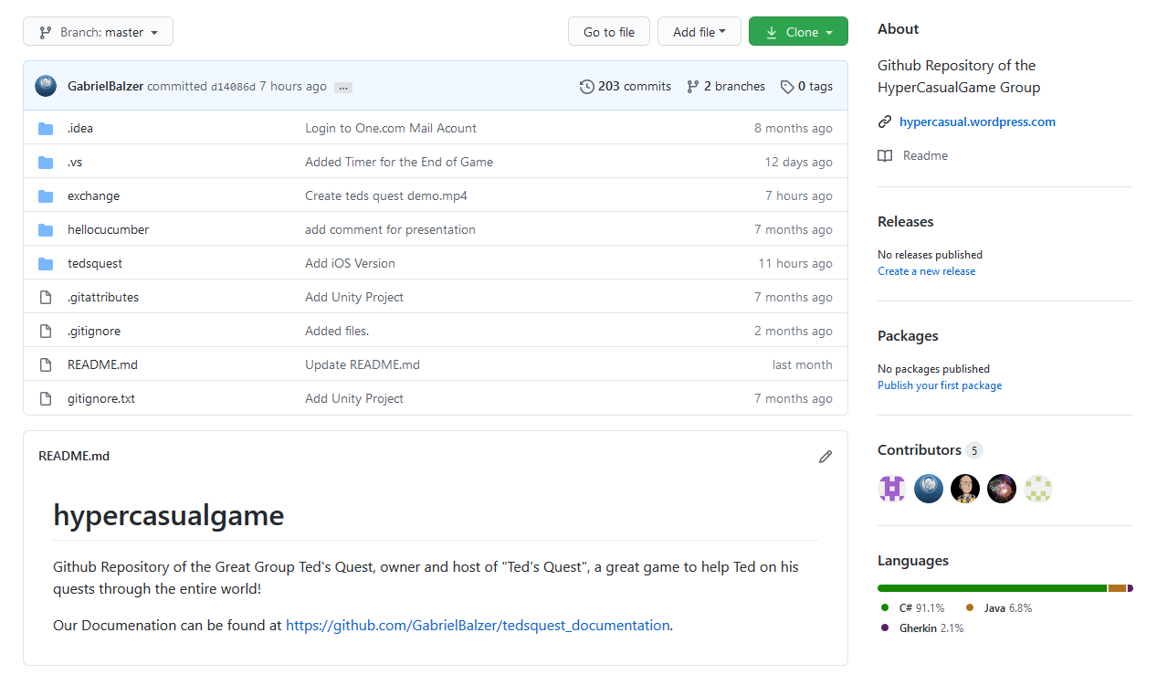
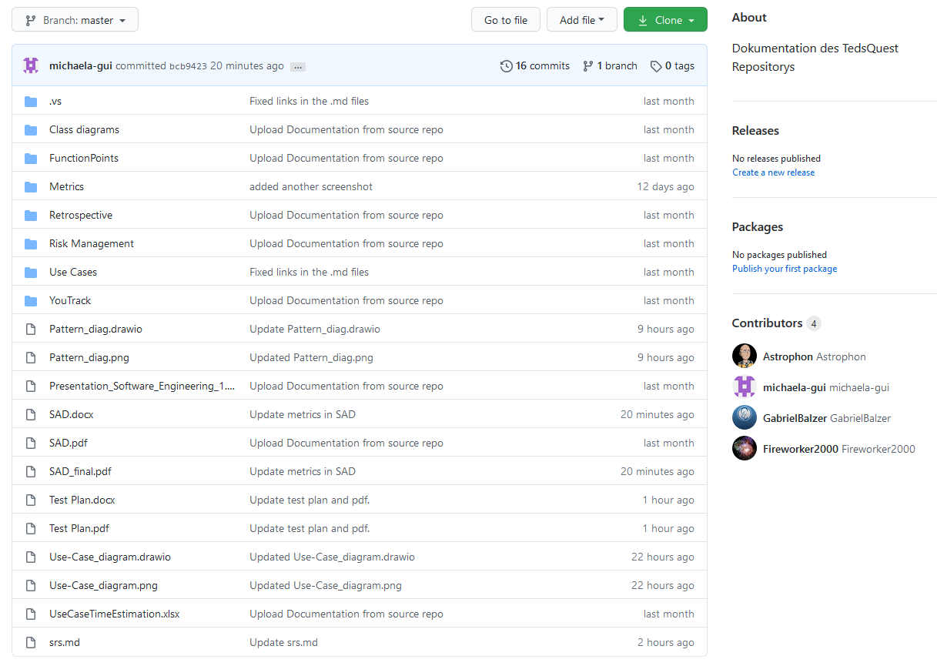
Management Methods - GitHub
01.07.2020
5

Slide 9
SAD and SRS
01.07.2020
6

Slide 10
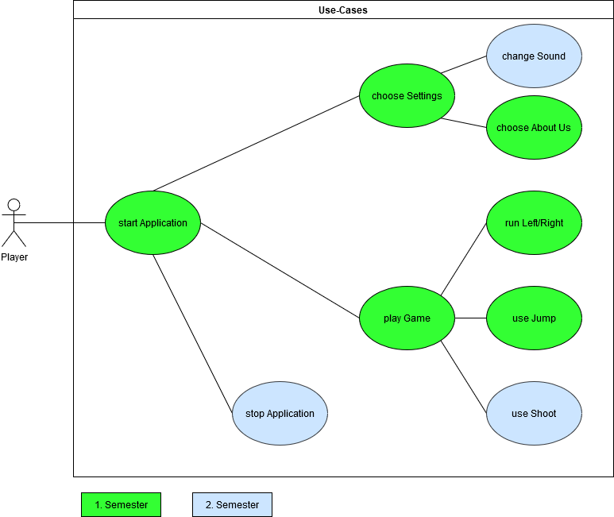
Scope – Overall User Case Diagram
01.07.2020
7

Slide 11
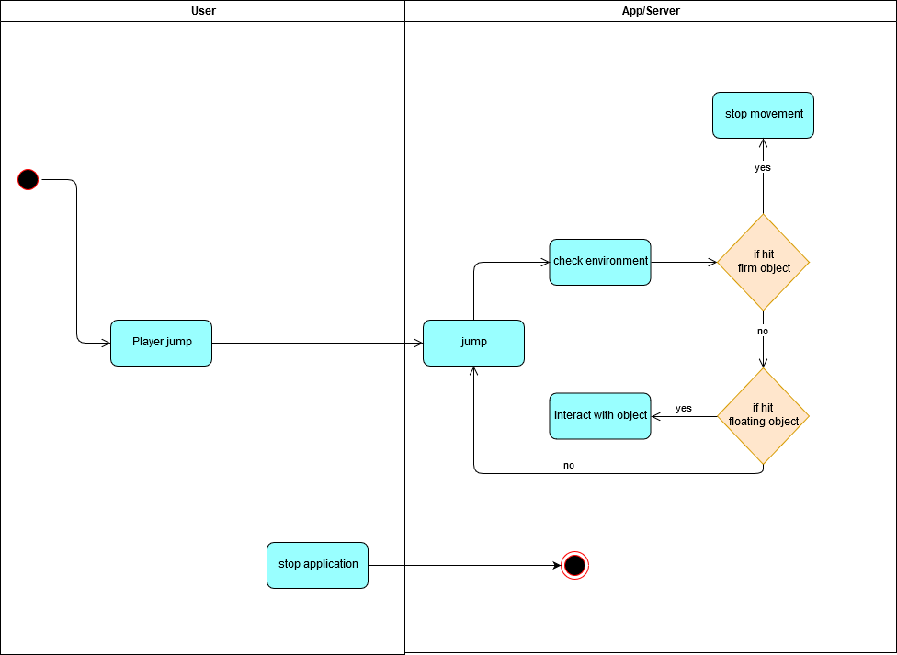
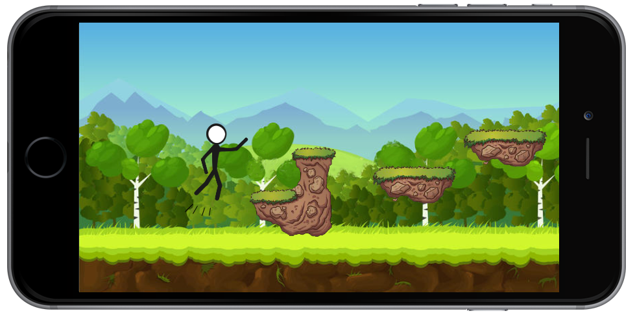
Use Case Jump
01.07.2020
8

Slide 12
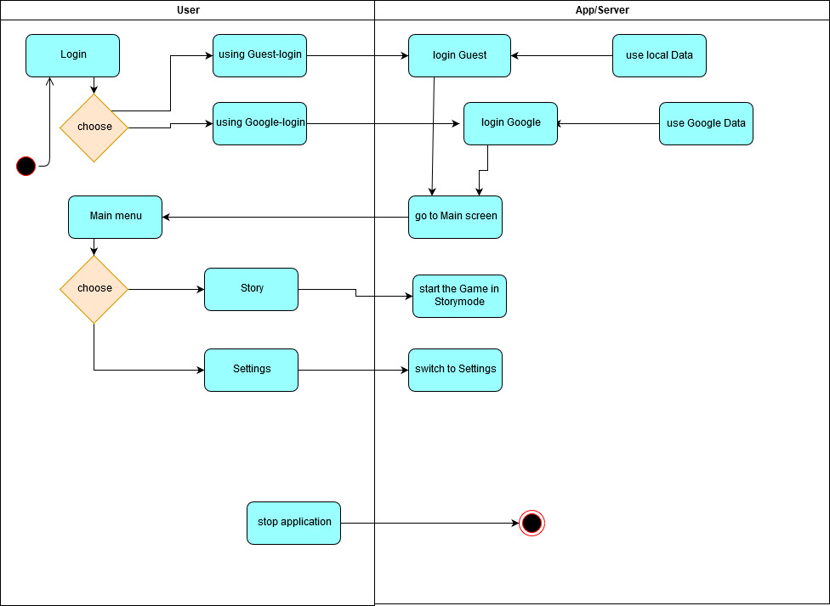
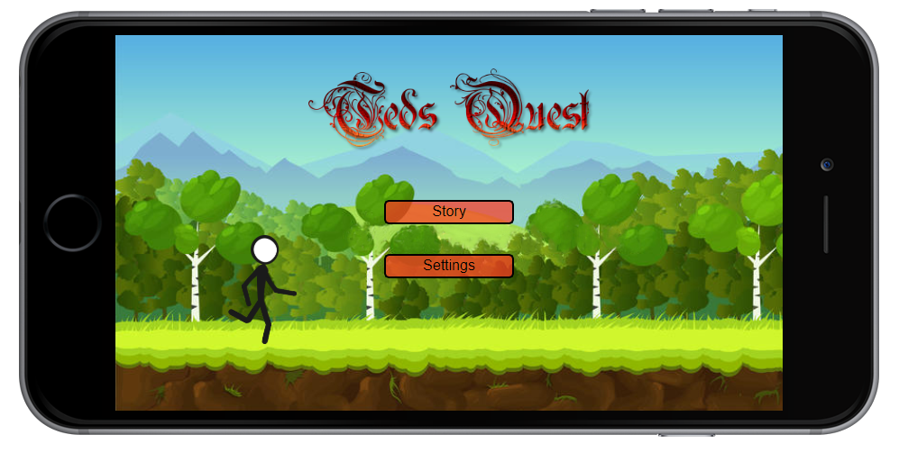
Use Case Main Menu
01.07.2020
9

Slide 13

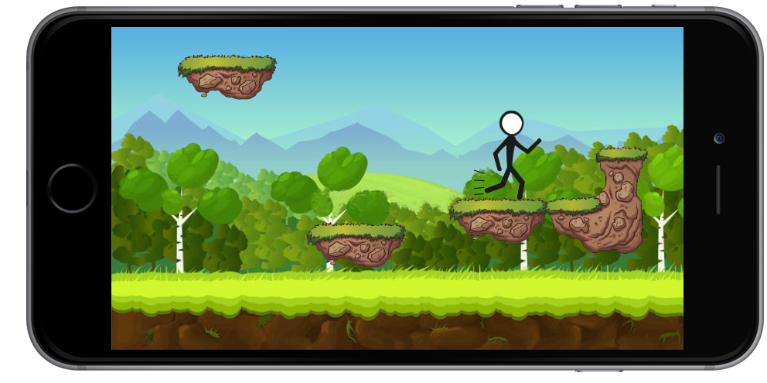
Use Case Move Right
01.07.2020
10

Slide 14
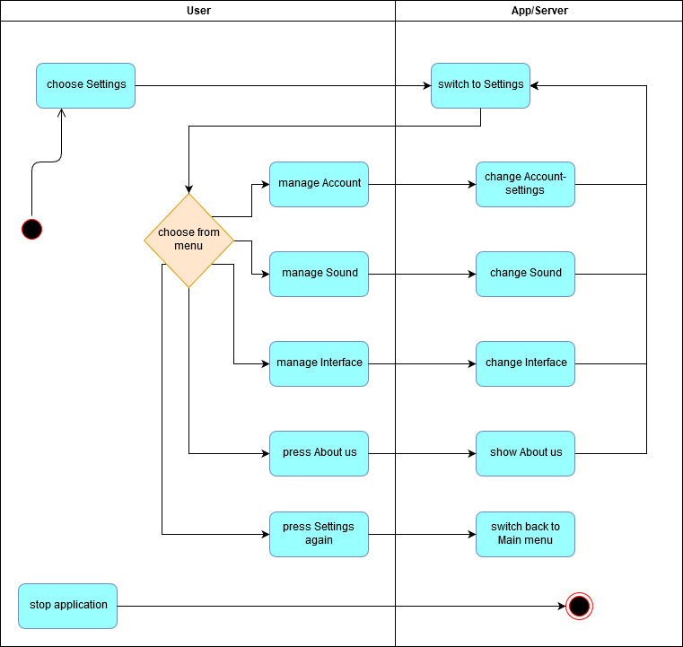
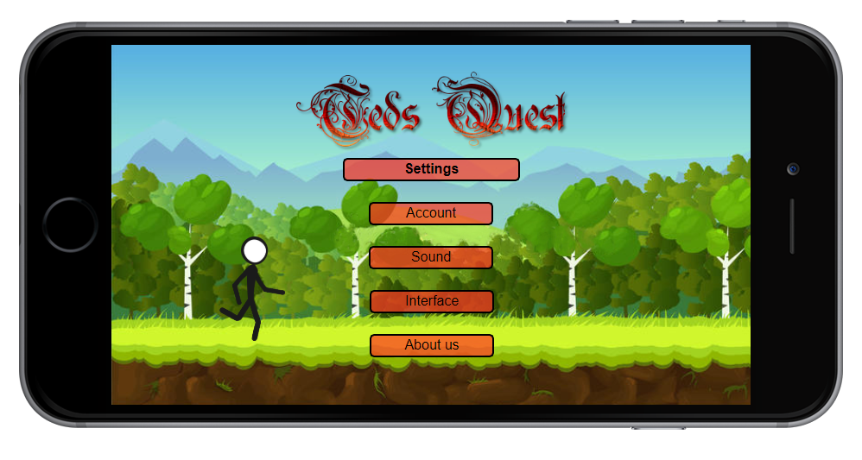
Use Case Settings
01.07.2020
11

Slide 15
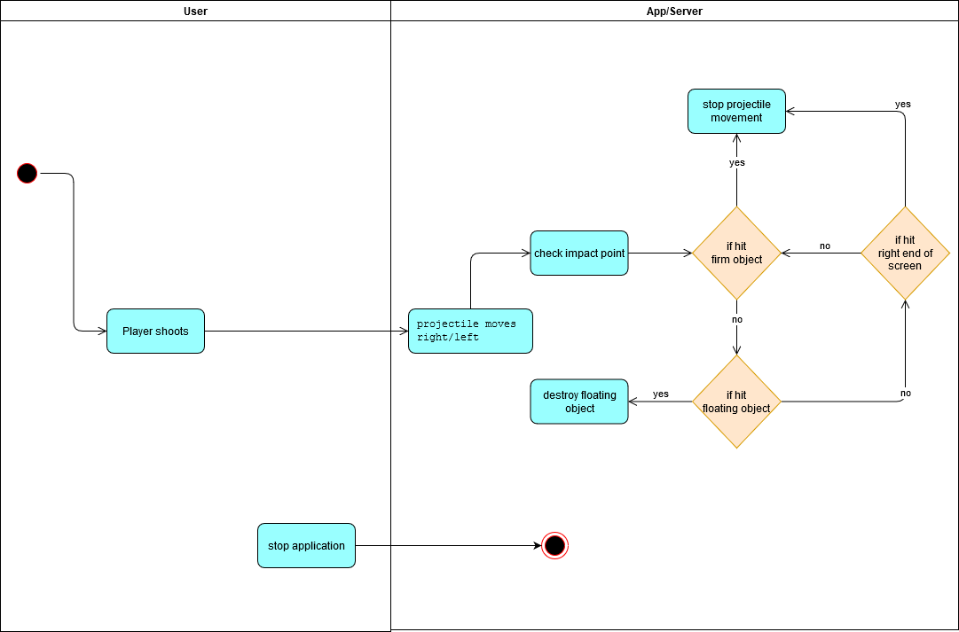
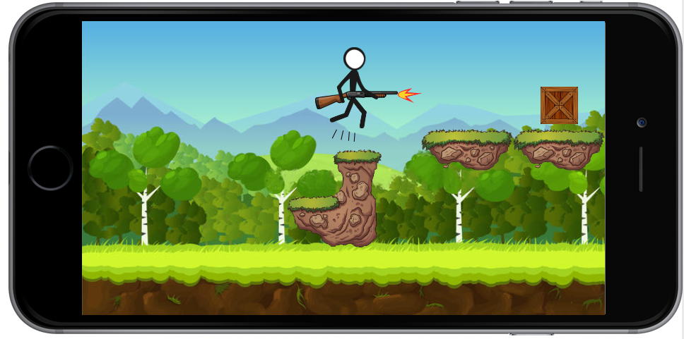
Use Case Shoot
01.07.2020
12

Slide 16
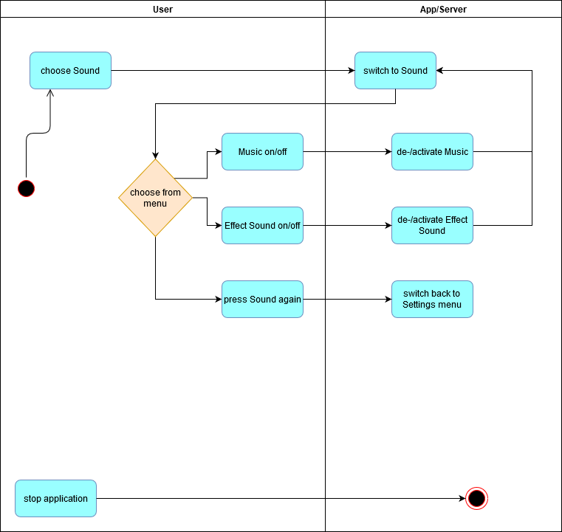
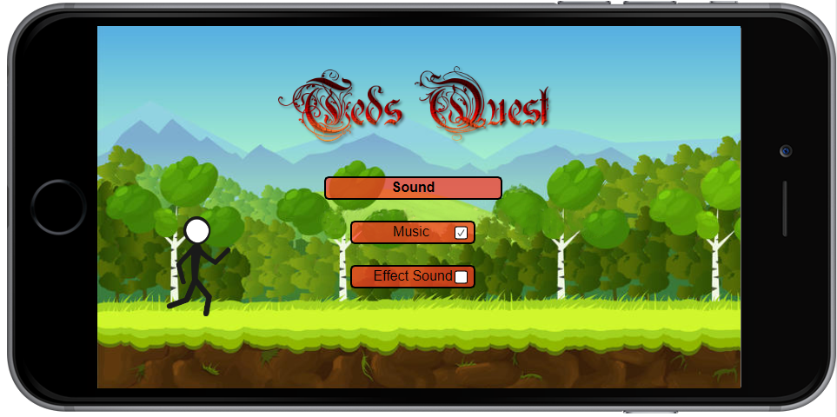
Use Case Sound Settings
01.07.2020
13

Slide 17
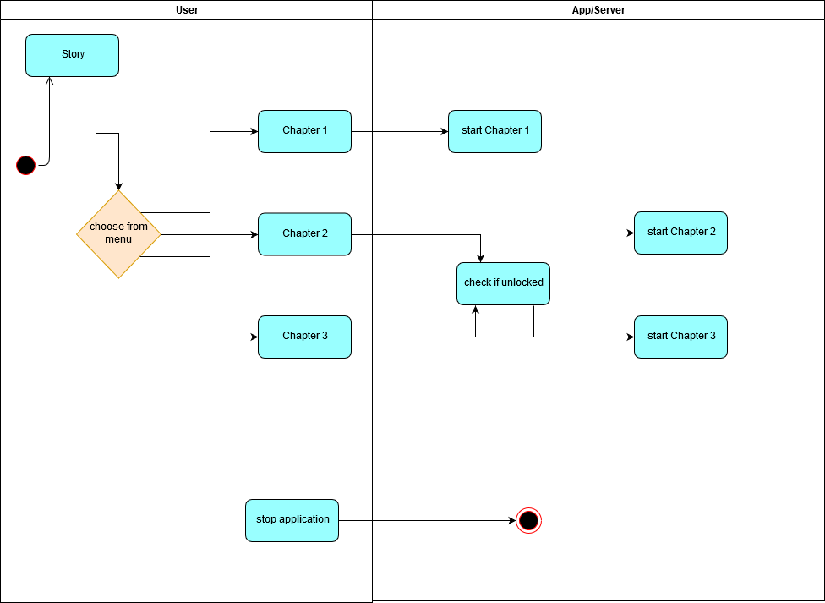
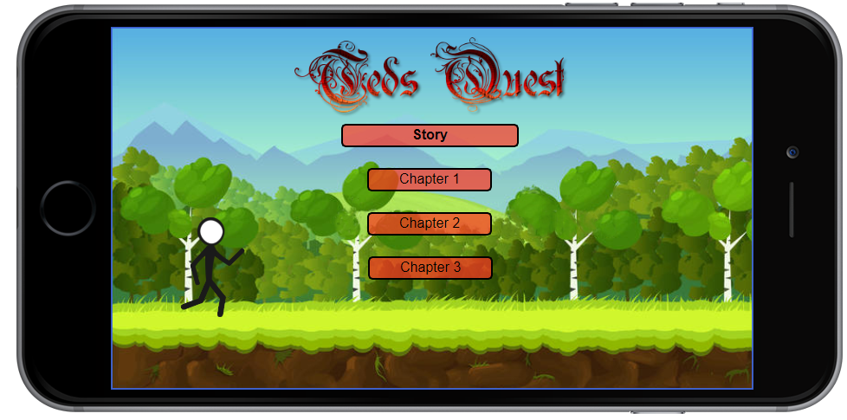
Use Case Story Menu
01.07.2020
14

Slide 18
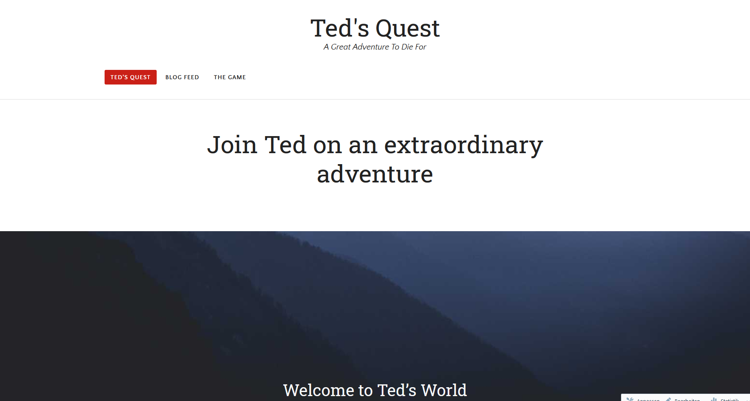
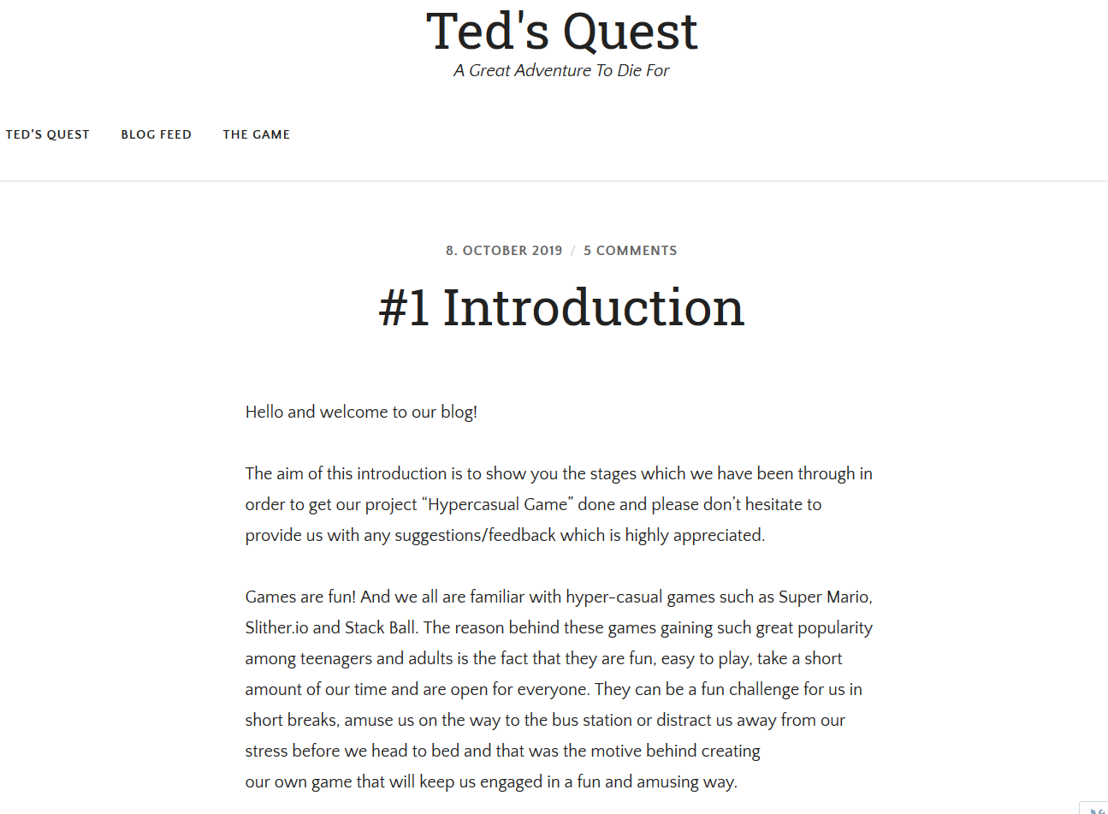
Blog
01.07.2020
15

Slide 19
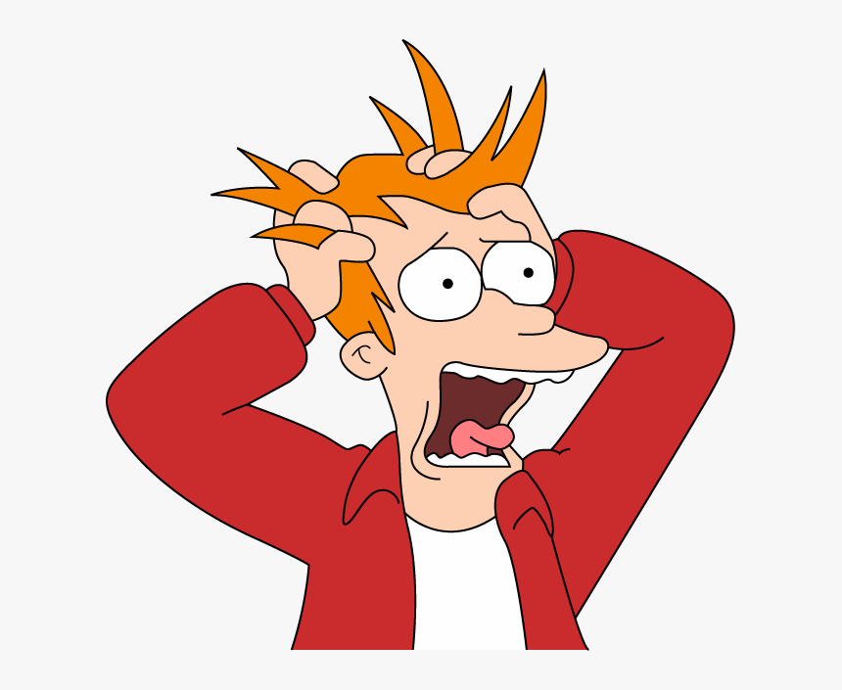
Risk Management
01.07.2020
16

Slide 20
Methodology
Agility [ok]
Scrum-based Management [ok]
01.07.2020
1

Slide 21

Strategy
First Level Development:
Game for Computer
1-2 manually crafted Levels
Second Level Development
Game for Android Smartphone
Infinite Mode
Additional manually crafted Levels
Third Level Development
Automatically generated Levels
Store for Clothing and Weapons
https://ak5.picdn.net/shutterstock/videos/7060045/thumb/3.jpg
01.07.2020
17

Slide 22
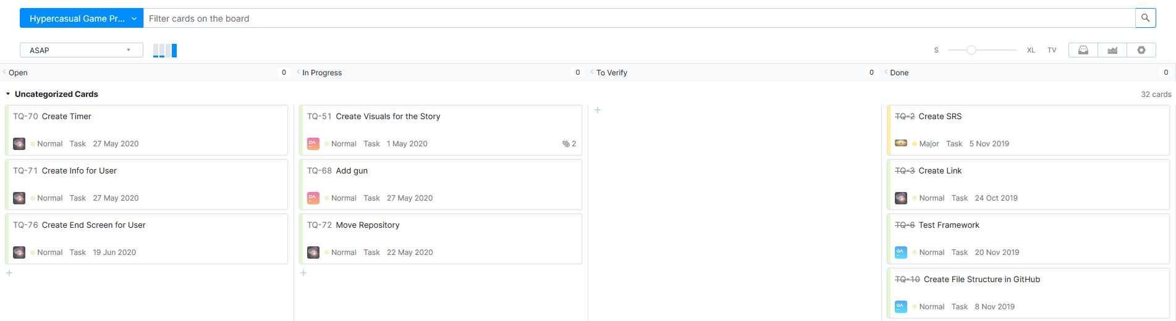
RUP als Modell
Agility
Scrum-based
01.07.2020
18

Slide 23
Implementation
Beispiel Code Metrics [ok]
Arbeit pro User
Reschedule Scope (für 2. Semester) -> Level? [ok]
Quality-Measurements (MVC, Config Mangement, Tools)
01.07.2020
1

Slide 24
Implementation and Quality

Slide 25
Repitition: Scope – Overall User Case Diagram
01.07.2020
20

Slide 26
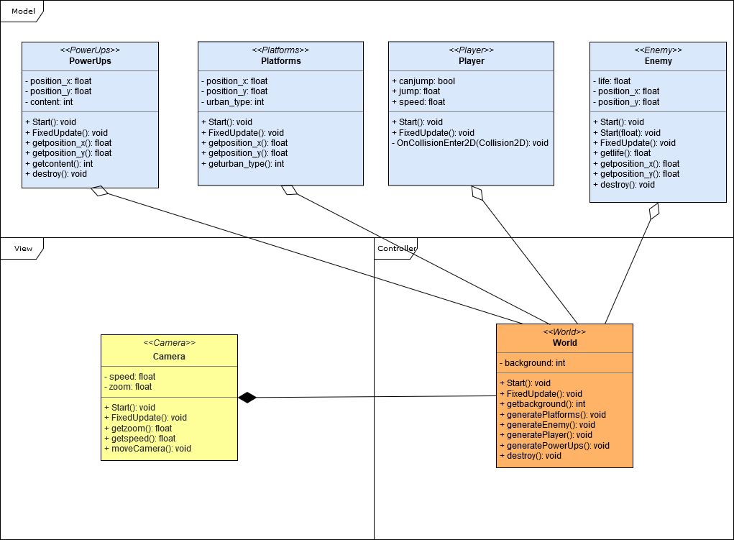
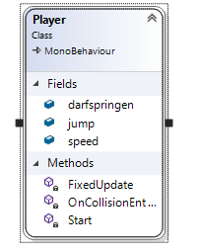
Technical Aspects
11.12.2019
20
01.07.2020

Slide 27
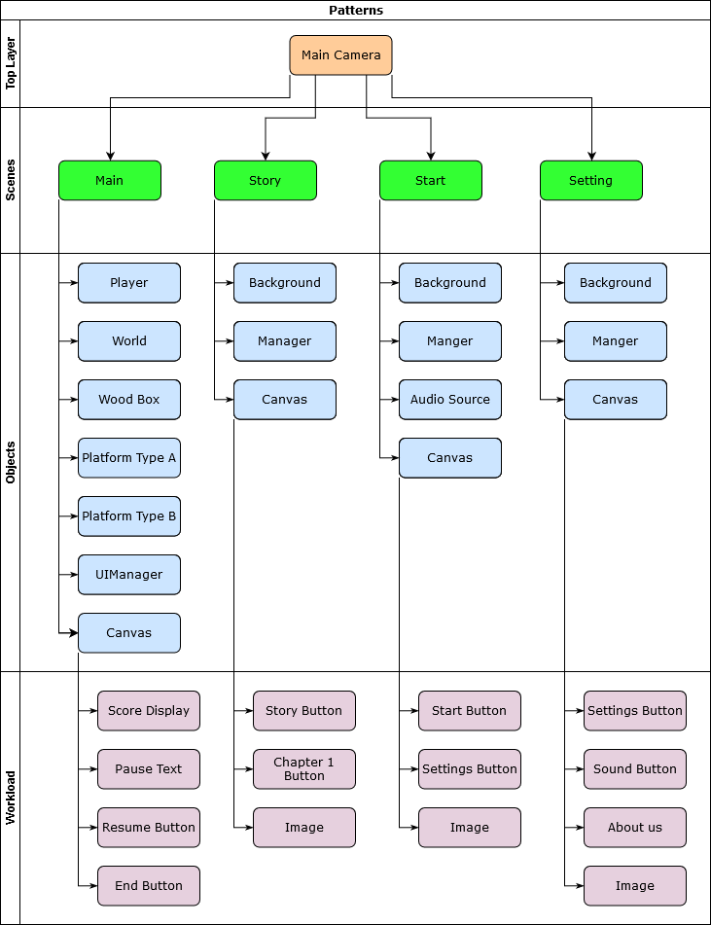
Design Patterns - Singleton
01.07.2020
21

Slide 28
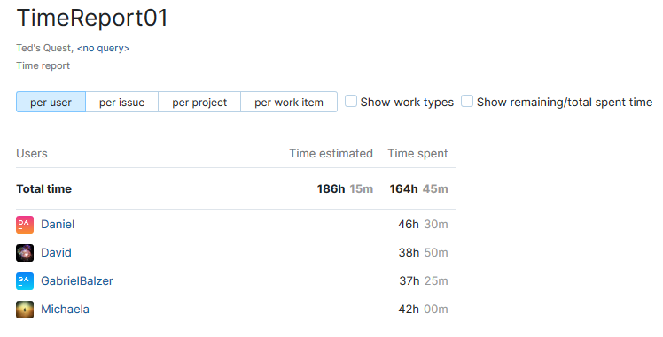
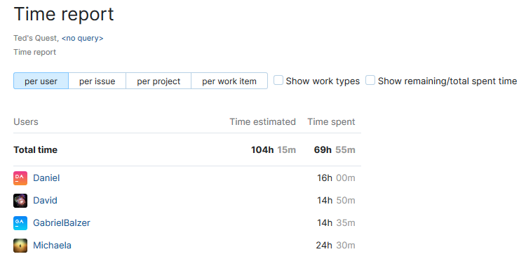
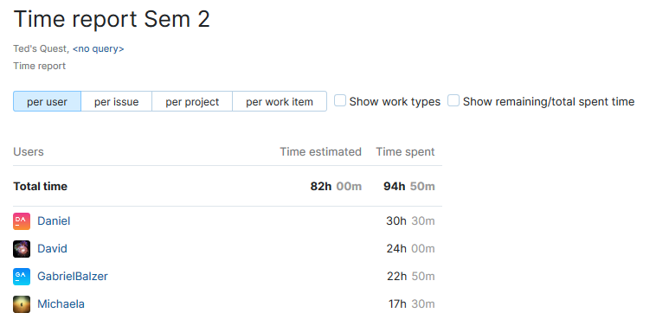
Workload per User
Semester 1
Semester 2
01.07.2020
22

Slide 29
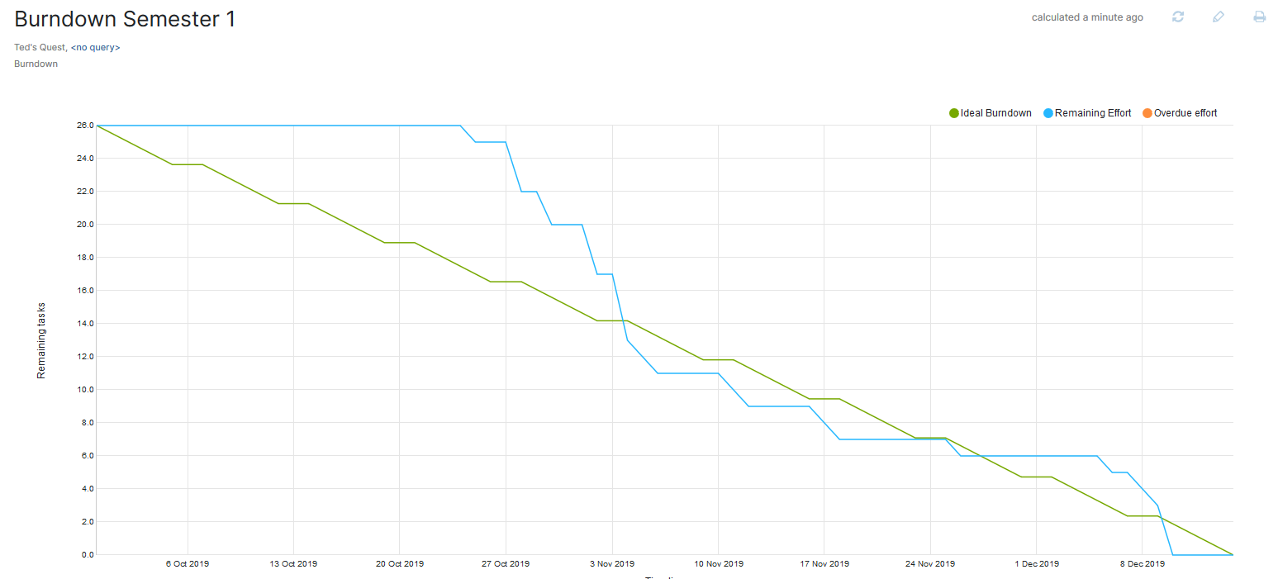
Burndown Time-Management per Issue
01.07.2020
1

Slide 30
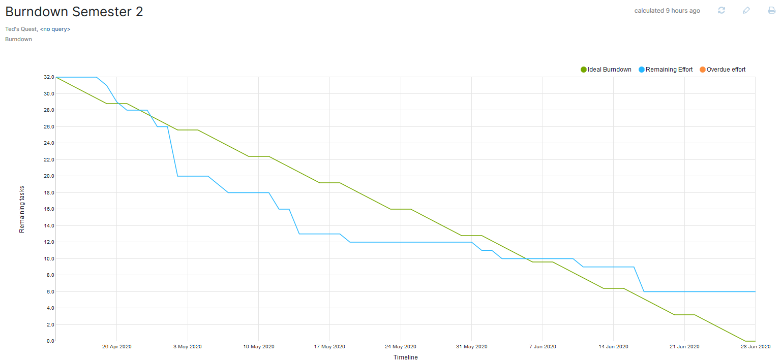
Burndown Time-Management per Issue
01.07.2020
1

Slide 31
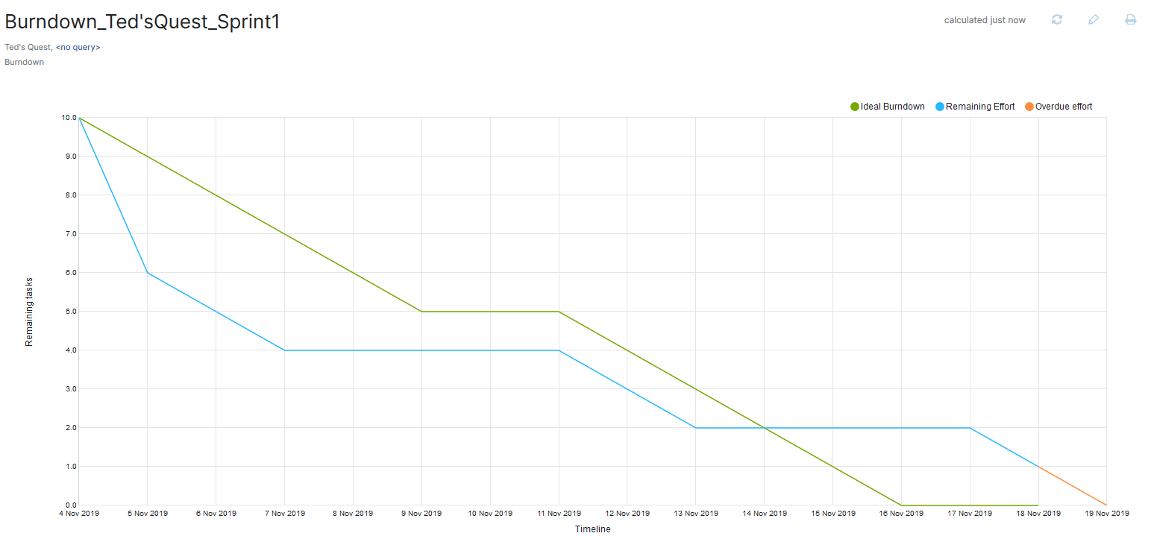
Burndown Time-Management per Issue
01.07.2020
23

Slide 32
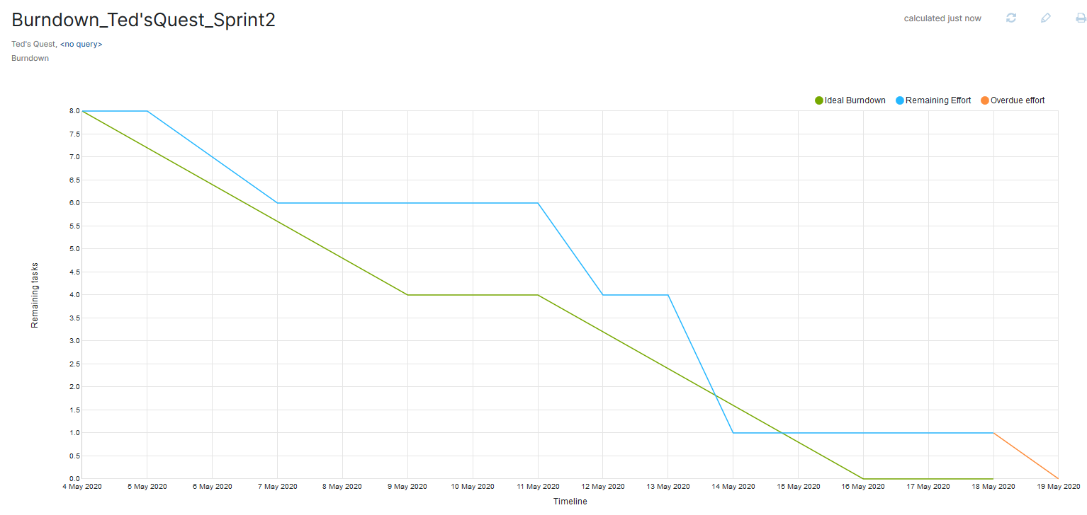
Burndown Time-Management per Issue
01.07.2020
24

Slide 33
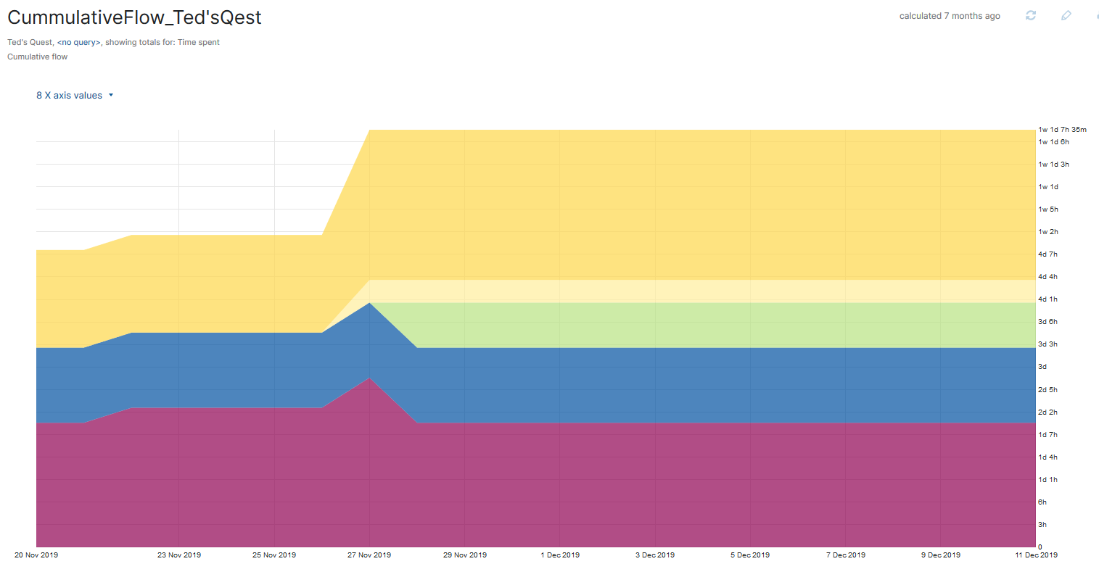
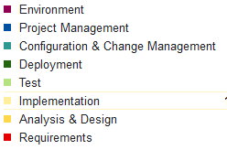
Cumulative Flow Diagram
01.07.2020
25

Slide 34
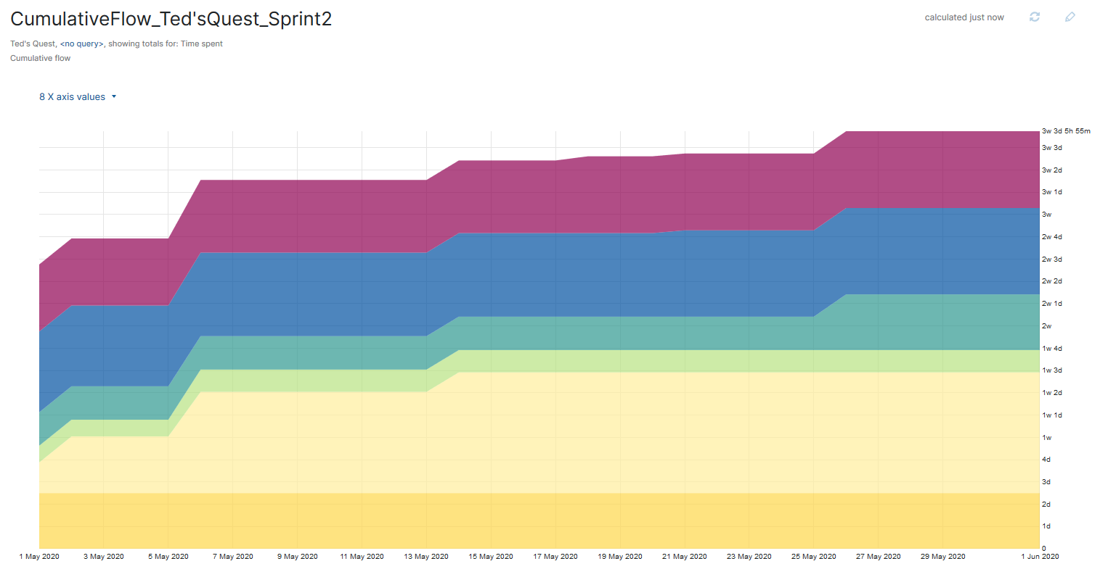
Cumulative Flow Diagram
01.07.2020
26

Slide 35
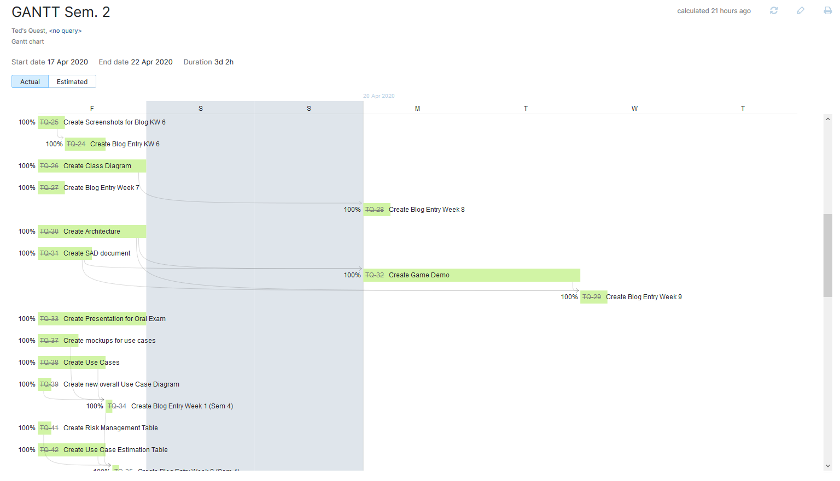
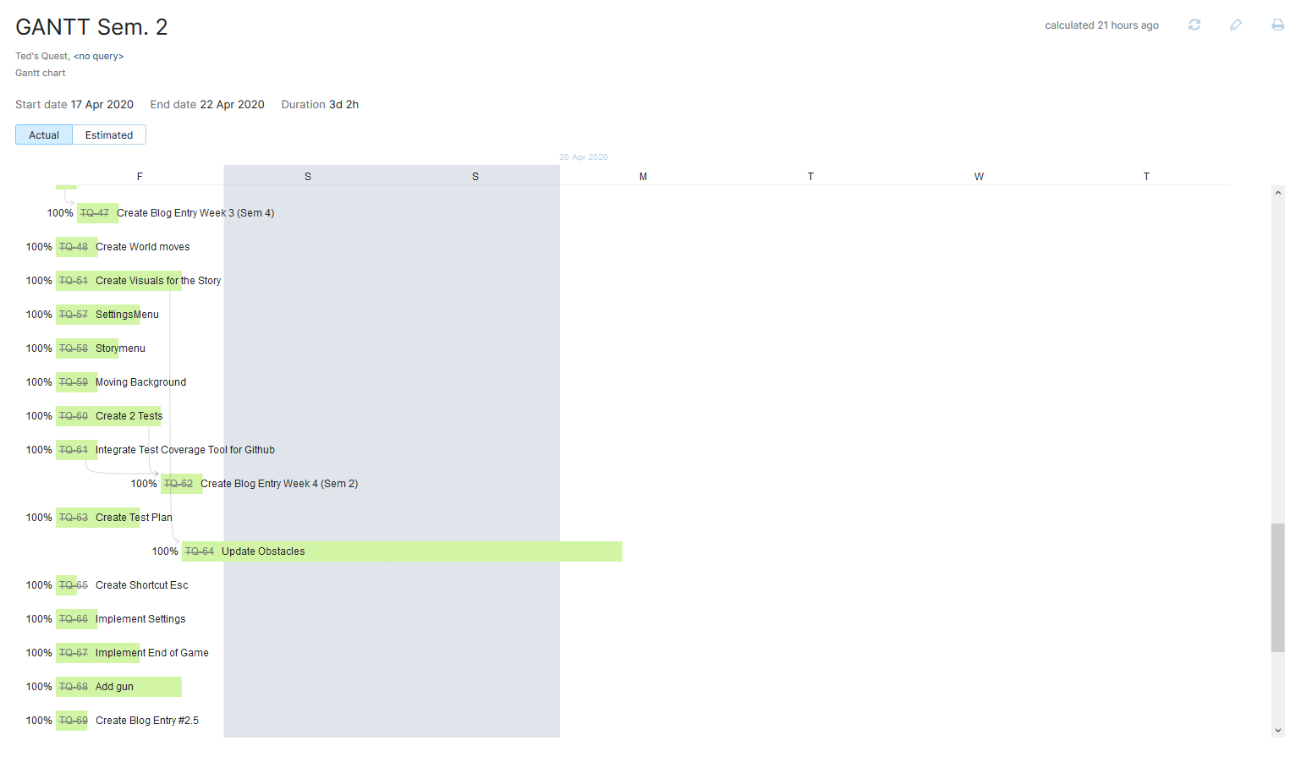
Gantt Chart
01.07.2020
27

Slide 36
Testing
Durchführung Testing (Functional testing, User testing) [ok]
Anschluss an feature files -> konnten nicht verwendet werden für spezifisches Projekt, jedoch testweise zuvor gezeigt [ok]
Testing Coverage (Codacy) [ok]
01.07.2020
1

Slide 37
Testing

Slide 38
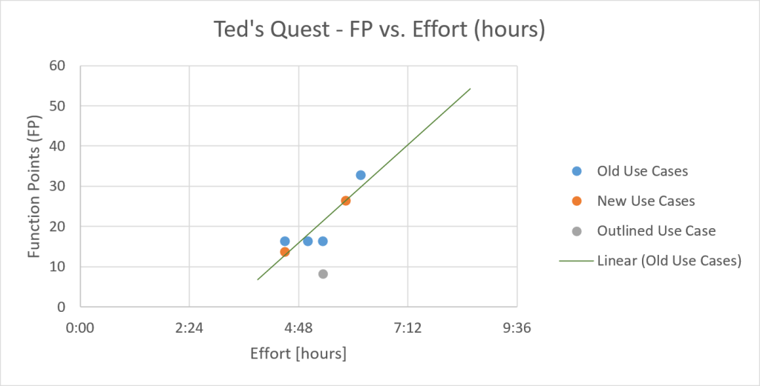
Function Points
01.07.2020
29

Slide 39
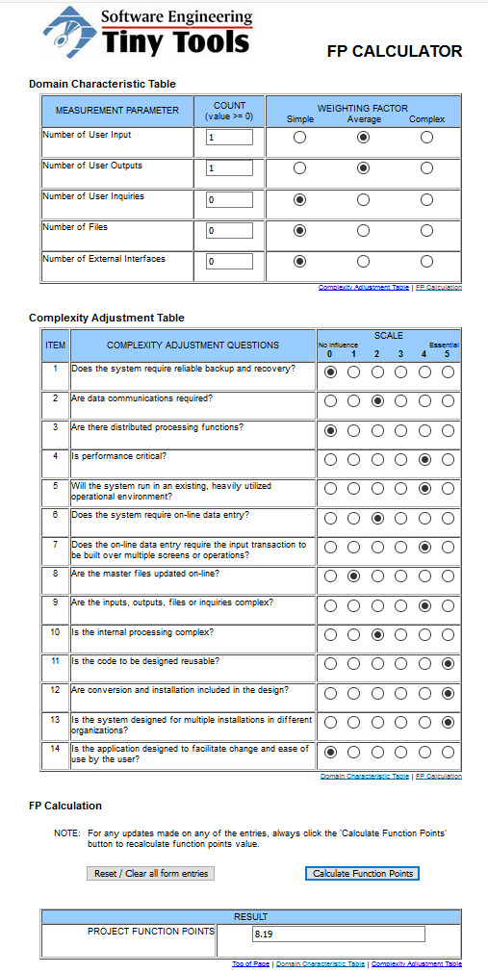
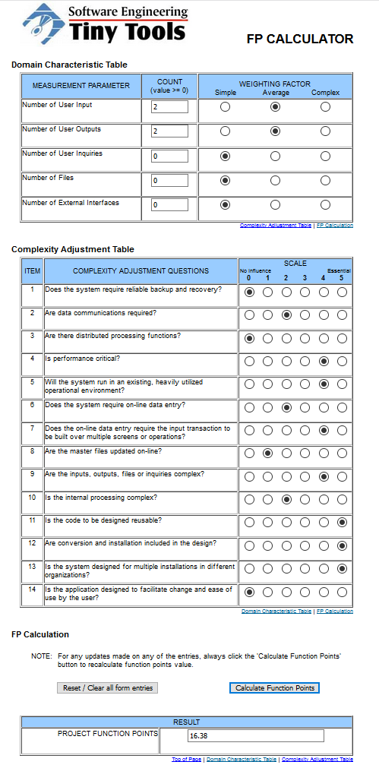
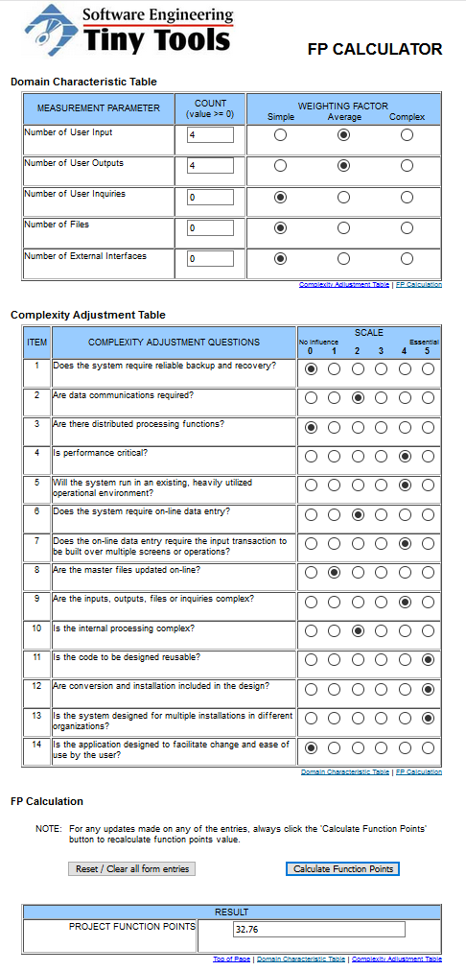
Function Points
01.07.2020
30

Slide 40
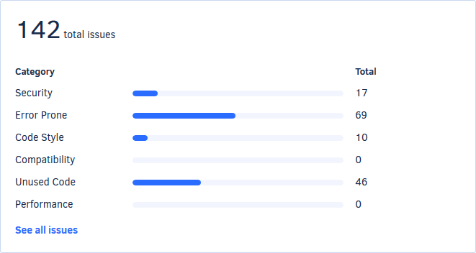
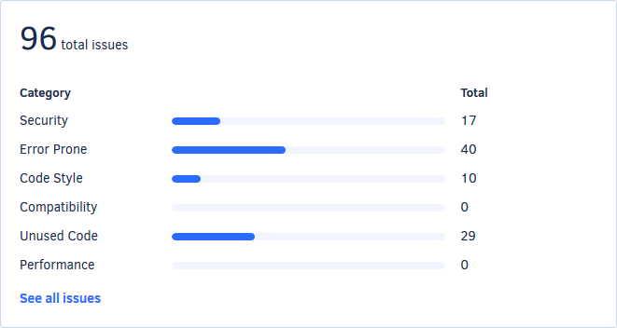
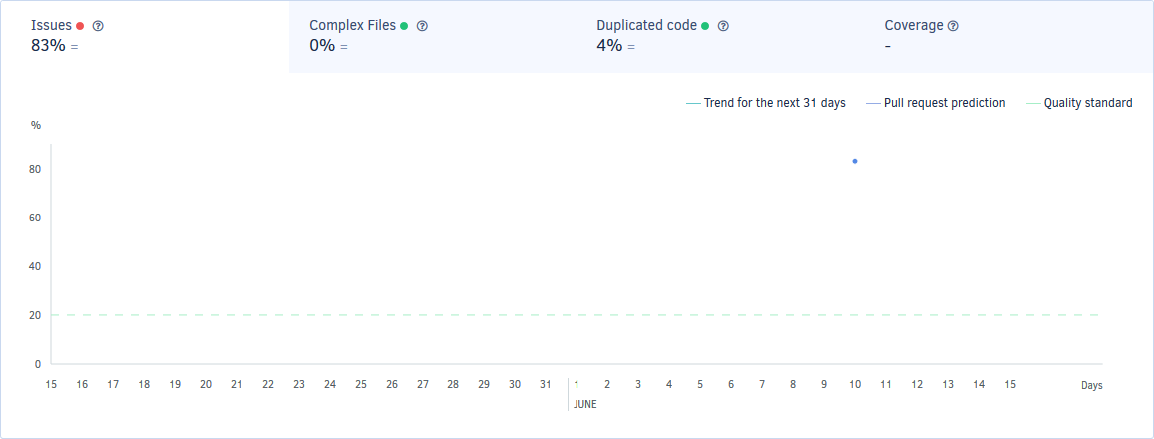
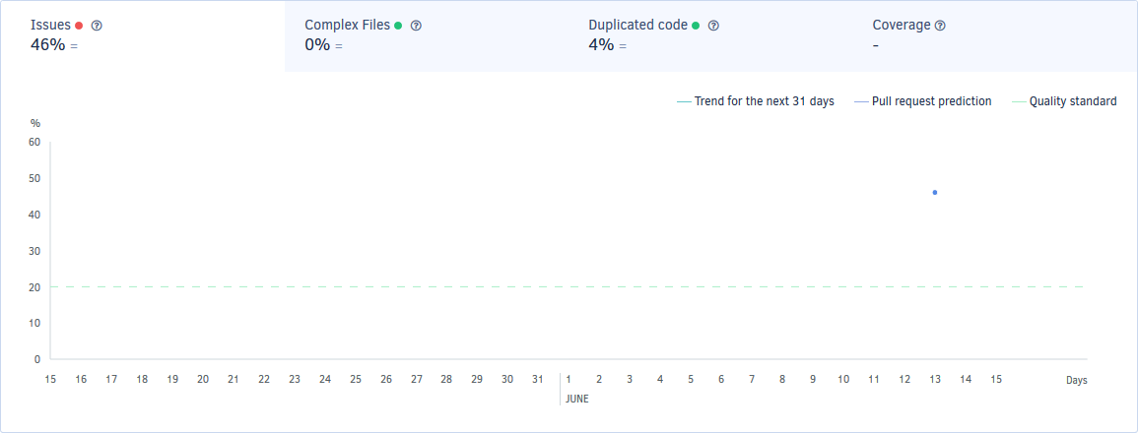
Metrics
Before Codacy
After Codacy
01.07.2020
31

Slide 41
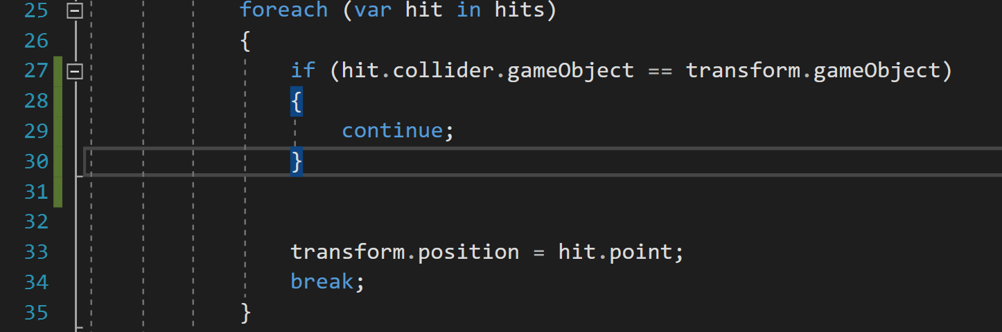
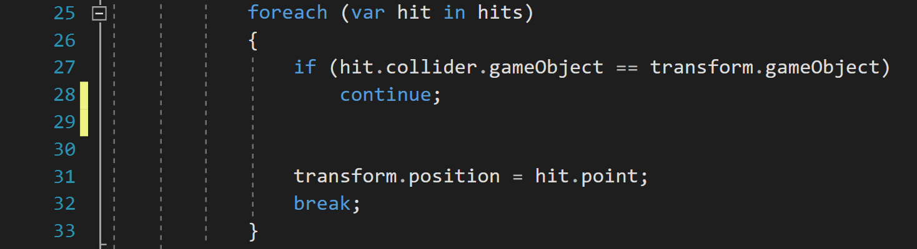
Metrics
Before
After
01.07.2020
32

Slide 42
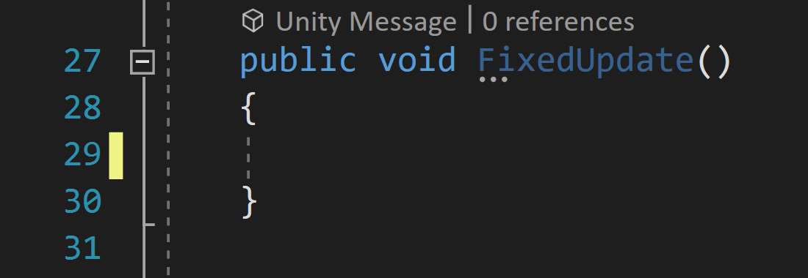

Metrics
Before
After
01.07.2020
33

Slide 43

Testing – feature files
01.07.2020
34

Slide 44
Test Plan
Evaluation Mission and Test Motivation
Target Test Items
Outline of Planned Tests
Test Approach
Entry and Exit Criteria
Devliverables
Testing Workflow
Environmental Needs
Responsibilities, Staffing, and Training Needs
Iteration Milestones
Risks, Dependencies, Assumptions, and Constrains
Management Process and Procedures
01.07.2020
35

Slide 45


Test Plan
01.07.2020
36

Slide 46


User Testing – Survey
Question
Result
01.07.2020
37

Slide 47
User Testing – Survey
Question
Result
01.07.2020
38

Slide 48


User Testing – Survey
Question
Result
01.07.2020
39

Slide 49


User Testing – Survey
Question
Result
01.07.2020
40

Slide 50



User Testing – Survey
Question
Result
01.07.2020
41

Slide 51
Demo

Slide 52

01.07.2020
43

